Slide 1
CMSC204
Kartchner
V(StateGraph) = {Oregon, Alaska, Texas, Hawaii, Vermont, NewYork, California}
E(StateGraph) = {(Alaska, Oregon), (Hawaii, Alaska), (Hawaii, Texas), (Texas, Hawaii), (Hawaii, California), (Hawaii, New York), (Texas, Vermont), (Vermont, California), (Vermont, Alaska)}
1. Draw the StateGraph
Oregon
Alaska
New York
California
Hawaii
Texas
Vermont

Slide 2
a. Show the adjacency matrix that would describe the edges in the graph. Store the vertices in alphabetical order
States
Alaska 0 0 0 0 1 0 0
California 0 0 0 0 0 0 0
Hawaii 1 1 0 1 0 1 0
New York 0 0 0 0 0 0 0
Oregon 0 0 0 0 0 0 0
Texas 0 0 1 0 0 0 1
Vermont 1 1 0 0 0 0 0
3. b. Show the adjacency lists
that would describe the edges in the graph
Alaska
Oregon
California
Hawaii
Alaska
California
New York
Texas
New York
Oregon
Texas
Hawii
Vermont
Vermont
Alaska
California

Slide 3
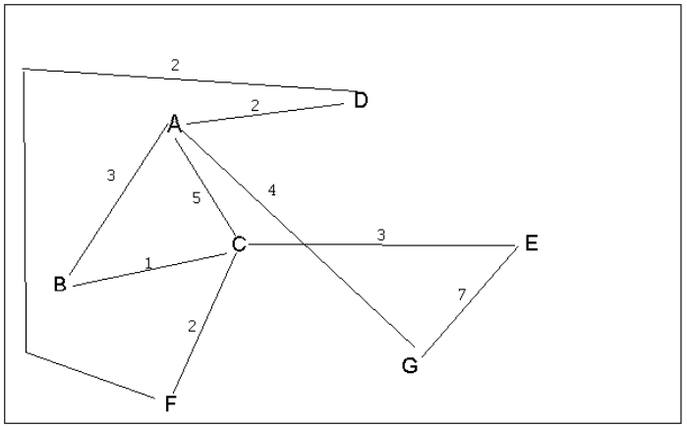
4 a. Which of the following lists the graph nodes in depth first order beginning with E?
A) E, G, F, C, D, B, A
B) G, A, E, C, B, F, D
C) E, G, A, D, F, C, B
D) E, C, F, B, A, D, G
4 b. Which of the following lists the graph nodes in breadth first order beginning at F?
A) F, C, D, A, B, E, G
B) F, D, C, A, B, C, G
C) F, C, D, B, G, A, E
D) a, b, and c are all breadth first traversals

Slide 4
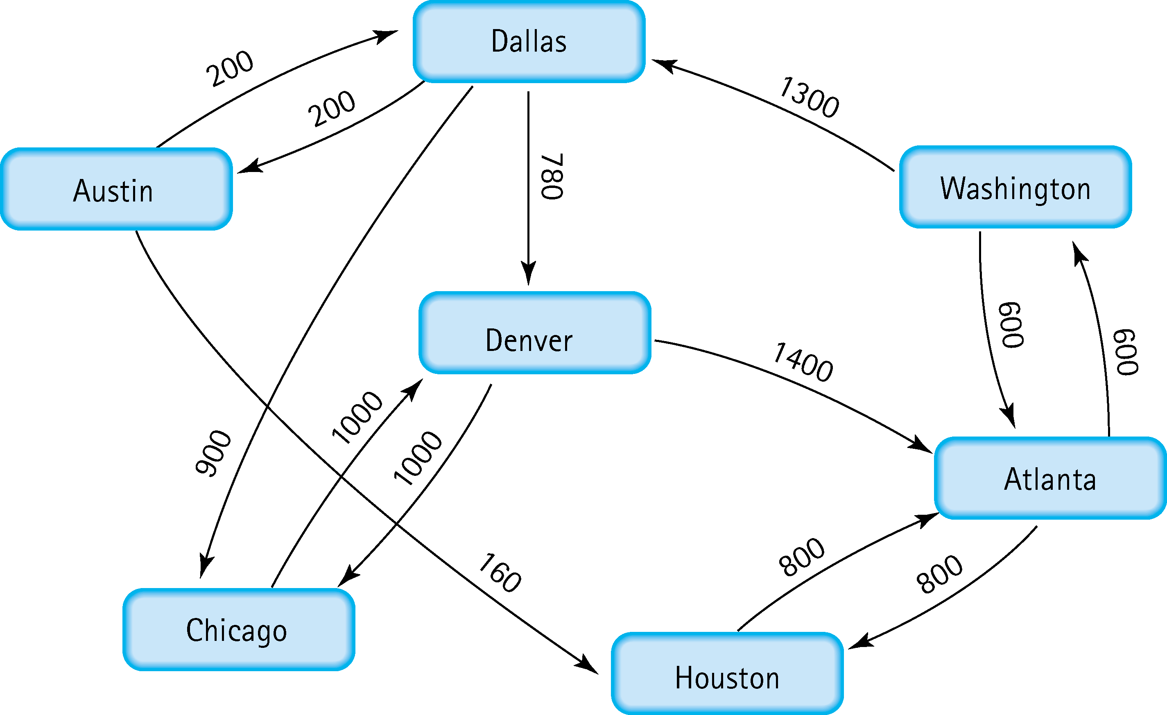
5. Find the shortest distance from Atlanta to every other city
Austin
Washington → Dallas→Austin which is 2100
Chicago
Washington → Dallas → Chicago which is 2800
Dallas
Washington → Dallas which is 1900
Denver
Washington → Dallas → Denver which is 2680
Houston
Houston which is 800
Washington
Washington which is 600

Slide 5
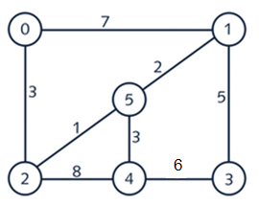
6. Find the minimal spanning tree using Prim’s algorithm. Use
0 as the source vertex . Show the steps.
3
0 → 2
3 1
0 → 2 → 5
3 1 2
0 → 2 → 5 → 1
3 1 2 3
0 → 2 → 5 → 1 → 4
3 1 2 3 5
0 → 2 → 5 → 1 → 4 → 3

Slide 6
7. Find the minimal spanning tree using Kruskal’s algorithm.
Show the weights in order and the steps.
2 → 5: 1 = 0+1=1
1 → 5: 3 = 1+2=3
0 → 2: 6 = 3+3=6
4 → 5: 9 = 6+3=9
1 → 3:14= 9+5=14

Slide 7
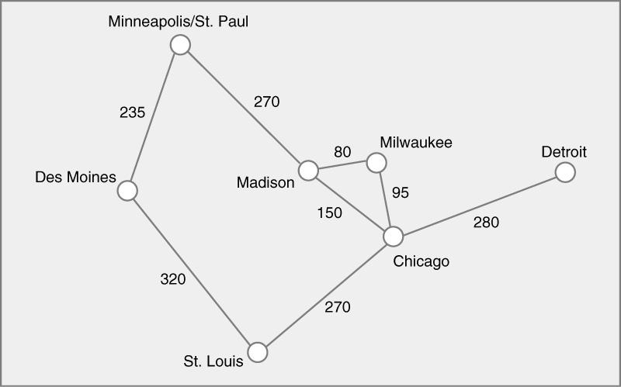
8. Find the minimal spanning tree using the algorithm you prefer. Use
Minneapolis/St. Paul as the source vertex
235
St.Paul→Des Moines
235 270
St.Paul→Des Moines→Madison
235 270 80
St.Paul→Des Moines→Madison →Milwaukee
235 270 80 95
St.Paul→Des Moines→Madison →Milwaukee →Chicago
235 270 80 95 270
St.Paul→Des Moines→Madison →Milwaukee →Chicago →St.louis
235 270 80 95 270 280
St.Paul→Des Moines→Madison →Milwaukee →Chicago →St.louis → Detroit

Slide 8
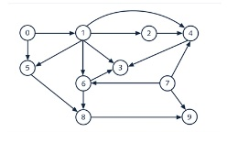
9. List the nodes of the graph in a breadth first topological ordering. Show the
steps using arrays predCount, topologicalOrder and a queue
Layer 5
0 0 0 0 0 0 0 0 0 0
Pred Count
0 1 2 3 4 5 6 7 8 9
Layer 1
0 1 1 3 3 2 2 0 2 2
Layer 2
0 0 1 3 2 1 1 0 2 1
Layer 3
0 0 0 2 1 0 0 0 2 1
Layer 4
0 0 0 1 0 0 0 0 0 1
topological Order
0,7,1,2,5,6,4,8,2,9
Queue
0,7 →1 →2,5,6 →4,8 →3,9

Slide 9
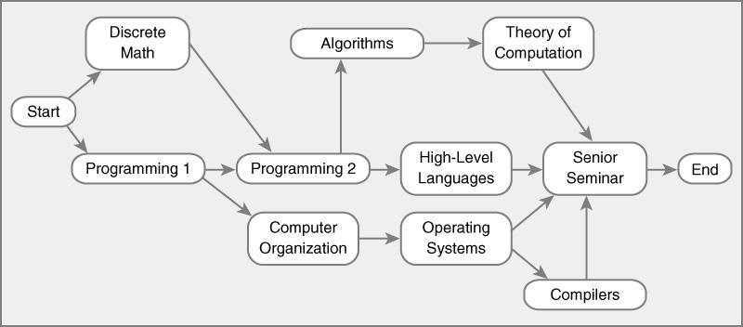
10. List the nodes of the graph in a breadth first topological ordering.
1). Start
2). Discrete Math
3). Programming 1
4). Programming 2
5). Computer organization
6). Algorithm
7). High level Languages
8).Operating Systen
9). Theory Computation
10). Compliers
11). Senior Seminar
12). End

